Slide 1
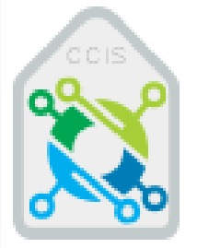

SALEK
For monitoring Water
Supervisor : Dr.Fahad Omar Alomary
Made by : Mohammed Mansour Bin Gasem – Abdulelah Abdullah Alotaibi – Abdullah Omran Alomran
Fall 2023 – Group #178

Slide 2
Introduction
Welcome to the innovative SALEK project! This project is designed to monitor the water level in tunnels during rainy situations and send timely notifications to the relevant authorities. By utilizing Internet of Things (IoT) technology, this project aims to enhance safety measures and minimize the risks associated with water accumulation in tunnels.This project is not just about mitigating risks, but it is also about utilizing cutting-edge technology to make the world a safer and better place.
Fall 2023 – Group #178

Slide 3
Outline
01
Problem Definition
02
Aims & Objective
03
Background
04
Related Work
05
System Analysis & Design
06
Conclusion
Fall 2023 – Group #178

Slide 4
Problem Definition
01
Fall 2023 – Group #178

Slide 5
Problem Definition
Many cities around the world face the problem of flooding tunnels during periods of heavy rains, and this leads to several economic and social problems.
There are many people who were affected by the sinking of tunnels, their vehicles were damaged and their trips were disrupted.
The occurrence of flooding in tunnels can cause traffic disruption and a risk to public safety.
Fall 2023 – Group #178

Slide 6
Aims & Objective
02
Fall 2023 – Group #178

Slide 7
Aims & Objective
Aim :
Objective :
Help the concerned sectors such as (Civil Defense, Traffic and the Ministry of Municipal and Rural Affairs and Housing) in facilitating traffic in tunnels.
Reducing injuries and risks resulting from rain and floods.
Absorb the largest number of problems of drowning and blockages and work to solve them as soon as possible.
Facilitate the movement of vehicle owners during rain and torrential rains.
Warning people about closed tunnels and staying away from them.
Fall 2023 – Group #178

Slide 8
Background
03
Fall 2023 – Group #178

Slide 9
Background
The Internet of Things (IoT) has changed the way we measure water levels.
Traditional methods of measuring water levels were manual labor and were often time consuming and inaccurate.
We can use IoT-based water level measurement systems in various fields such as irrigation, flood control, and water supply management.
IoT-based water level measurement systems have the potential to improve water management, conserve water resources, and protect the environment by providing accurate, real-time data on water levels.
Fall 2023 – Group #178

Slide 10
Background (Cont)
Using the Internet of Things (IoT) has many benefits, including:
Improve efficiency and productivity.
Cost saving
Better data collection and analysis
Enhanced safety and security
Remote monitoring and control
Fall 2023 – Group #178

Slide 11
Related Work
04
Fall 2023 – Group #178

Slide 12
Related Work
In related works, we found several scientific papers that speak in our field:
According to " Internet of Water Things: A Remote Raw Water Monitoring and Control System.“ The scientific paper published on IEEE
This study aims to develop a new online system called the Internet of Water Things (IOWT) for monitoring and managing water resources.
The system is based on a serverless architecture and an IoT architectural reference model.
The system is tested in a simulated environment using electronic devices such as level sensors, temperature sensors, and rain gauges.
Data is collected and analyzed, then transmitted over the 3G network and processed.
Fall 2023 – Group #178

Slide 13
Related Work (Cont)
According to “Surface Water Monitoring Systems – Importance of Integration of Information Sources for Sustainable Watershed Management.” The scientific paper published on IEEE
A framework is proposed to integrate all water monitoring approaches, sampling techniques, and predictive models to provide comprehensive environmental assessment information.
The study recommends integrating discrete modeling approaches through integrated semi-automated models, data science and artificial intelligence.
To achieve an overall goal of standardized water management through the implementation of integrated water monitoring systems.
Fall 2023 – Group #178

Slide 14
System Analysis & Design
05
Fall 2023 – Group #178

Slide 15
Requirements Elicitation Techniques
A questionnaire is a research tool used to gather information from respondents by presenting them with a series of questions or prompts.
A Google Form was used to publish the questionnaire. There were 550 respondents and 169 answers.
Fall 2023 – Group #178

Slide 16
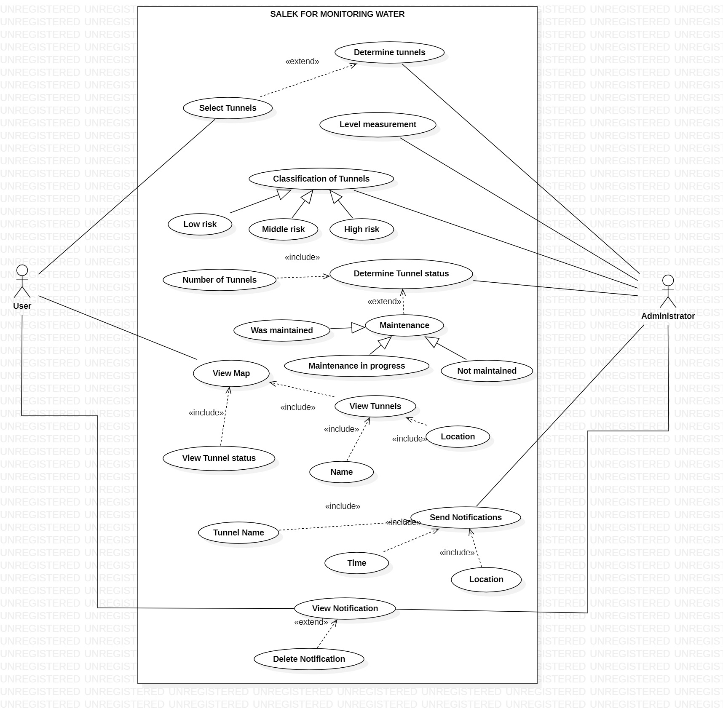
System Analysis & Design
Use case diagram :
Figure 1. Use case diagram.
Fall 2023 – Group #178

Slide 17
System Analysis & Design (Cont)
Tabel 1. description of send notification use case.
Use case name: | Send notification.
Scenario: | The administrator sends notifications to the user to inform him of the current tunnel status.
Brief description: | In the event of a change in the current tunnel status (tunnel classification), the administrator sends notifications to the user to inform him of the tunnel status. The notification includes the tunnel name, location, notification content and the time of the change, as well as the user's ability to delete the notification, knowing that there is a search box for notifications according to the date
Actors: | Administrator.
Flow of activities: | 1-Actor: - The administrator sets the tunnel classification. -Connect it with SALEK system. | 2-System: -Configure the tunnel status. - Sending notifications to inform the user.
Descrirtion of send Notification use case :
Fall 2023 – Group #178

Slide 18
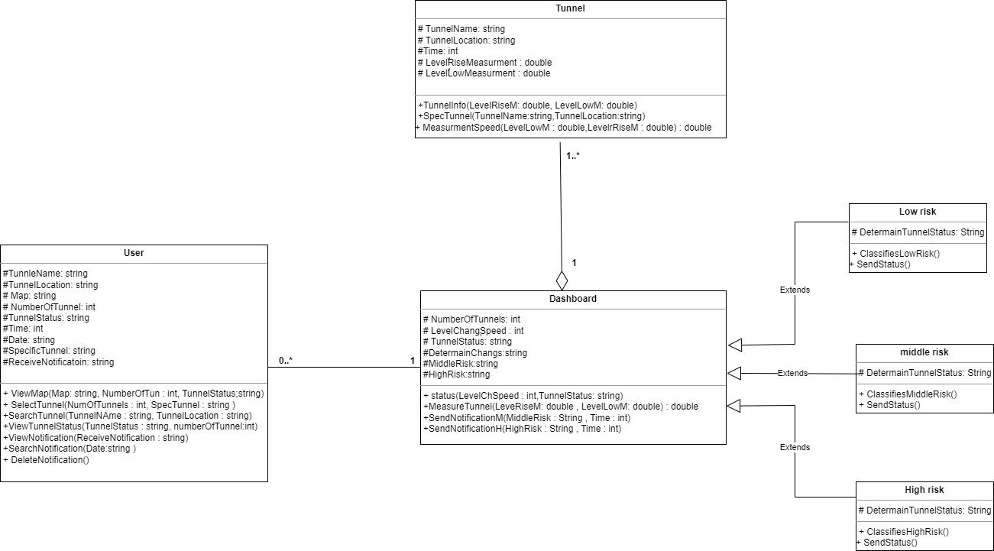
System Analysis & Design (Cont)
Class diagram :
Figure 2. Class diagram.
Fall 2023 – Group #178

Slide 19
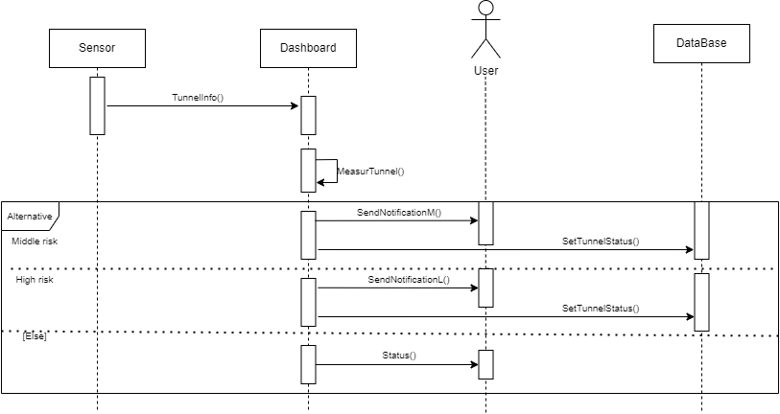
System Analysis & Design (Cont)
Sequence diagram :
Figure 3. SendNotification(). Sequence diagram.
Fall 2023 – Group #178

Slide 20
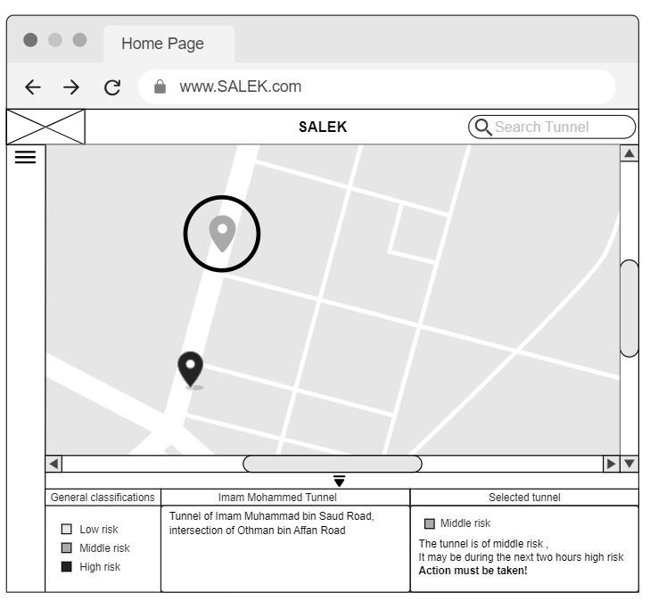
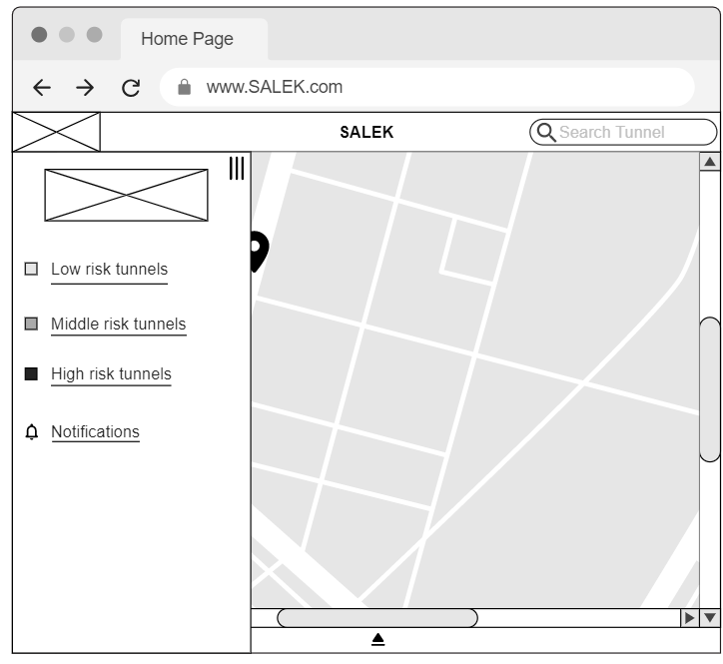
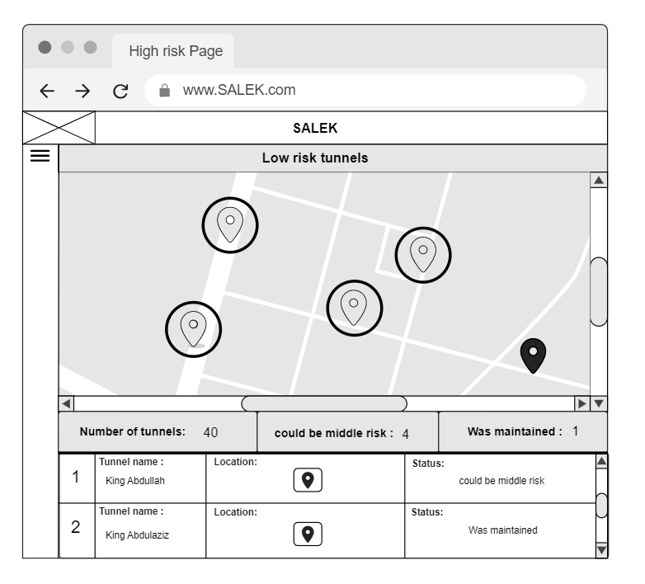
System Analysis & Design (Cont)
1
2
3
Figure 3. User interface prototype.
Fall 2023 – Group #178

Slide 21
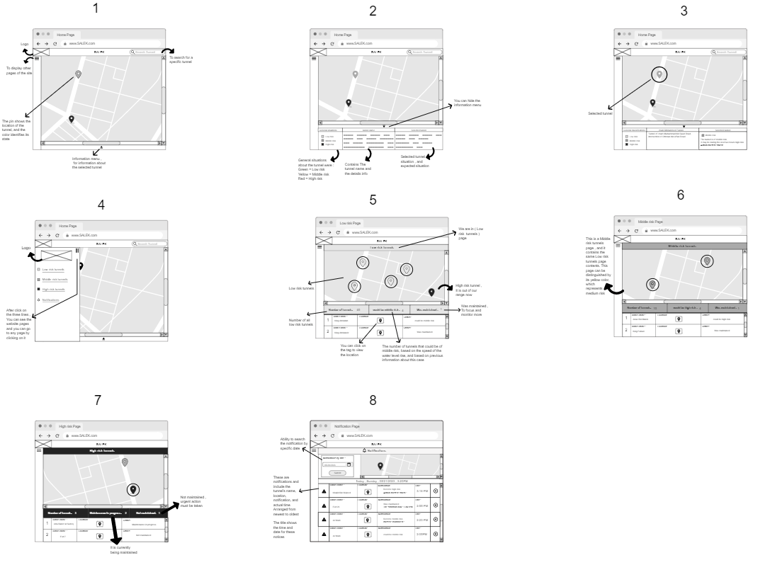
System Analysis & Design (Cont)
Figure 4. All screen interface prototype.
Fall 2023 – Group #178

Slide 22
Conclusion
06
Fall 2023 – Group #178

Slide 23
Conclusion
The SALEK project is a shining example of how technology can be used for the benefit of society, and is a major breakthrough in the field of Internet of Things. This project is evidence of the ability to innovate and create in our current era.Given the potential for inspiration and pioneering initiatives offered by the country, we hope that Salik will cover all logistical lines in the future.
Fall 2023 – Group #178

Slide 24
Any Question ?
Feel free to ask !
Fall 2023 – Group #178

Slide 25
Thank You
For your listening
Supervisor : Dr.Fahad Omar Alomary
Made by : Mohammed Mansour Bin Gasem – Abdulelah Abdullah Alotaibi – Abdullah Omran Alomran
Fall 2023 – Group #178

